Slide 1
Basic Electrical Technology Introduction
Dr. LakshmanRao S. Paragond
Faculty Dept of Electrical and Electronics Engg
laxman.sp@manipal.edu
Mobile : 9448835163

Slide 2
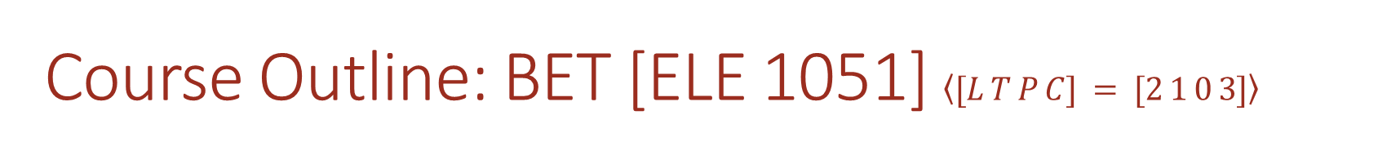
Course Outline: BET [ELE 1051] $\left\langle [L T P C] = [2 1 0 3]\right\rangle$
DC Circuit Analysis:
Circuit elements, Sources, Resistance, Inductance, Capacitance, Mesh Current and Node Voltage Analysis, Superposition, Thevenin’s and Max Power Transfer Theorems
Magnetic Circuit Analysis and Electromagnetism:
Magnetism, Laws of magnetism, series and parallel magnetic circuits, Electromagnetic induction, Magnetic coupling, induced emfs, mesh current equations
Single phase AC Circuit Analysis:
Generation, Representation, AC through R, L and C, Series and parallel circuits, Power, Power factor, Resonance in series and parallel AC circuits

Slide 3
Course Outline ELE 1051 [2 1 0 3]
3 phase AC Circuit Analysis:
Generation, Representation, Types of connection – Star & Delta, Analysis of balanced and unbalanced loads, Measurement of Power
Overview of Power System Components:
Electrical Power System – An overview, Generation, Transmission, Distribution, Utilization of Electric Power; Overview of Electrical Machines, Types, working principle & applications; Measurement of Energy: Energy meters
Course Plan

Slide 4
Assessment
In-Semester Assessment - 50%
2 Sessionals: 15 marks each – 1 hour duration
4 Quizzes : 5 marks each – 20 minutes
End-Semester Examination – 50%
Written Examination : 50 marks – 3 hours duration
Minimum Pass Marks for End Semester Exam: 18 marks
In order to clear the course a student must secure minimum pass marks (which could be between 35 to 50 marks) which is calculated by adding the marks obtained in In-Semester and End-Semester Exams.
All questions are to be answered
Attendance requirement : 75 % (which is regularly updated in SLcM)
NO use of Mobiles in the classroom.
Maintain Lecture Notes
Bring Calculators

Slide 5
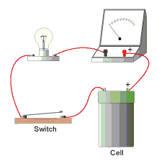
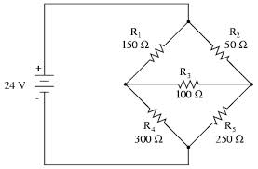
What is an Electric Circuit?
Definition:
“An interconnection of simple electrical devices with at least one closed path in which current may flow”

Slide 6
Circuit Elements
Active & Passive
Active Elements: Voltage & Current Source
Passive Elements: Resistor, Inductor & Capacitor
Linear & Non-linear Elements
Linear: Resistor, Inductor, Capacitor
Nonlinear: Diode, LDR (Light Dependent Resistor), Thermistor, transistor
Unilateral & Bilateral Elements
Unilateral (Current Flow in one direction): Diode, Transistor
Bilateral: Resistor, Inductor, Capacitor*
Lumped & Distributed
Discuss only lumped linear bilateral circuit elements

